Slide 1

15CSE301 Computer Organization and Architecture
Floating point representation
Arthmetic
Reference:
Chapter 3
Computer Organization and Design, The hardware / software interface, 3rd Edition
Dr Ganesh Neelakanta Iyer
Associate Professor, Dept of Computer Science and Engg
Amrita Vishwa Vidyapeetham, Coimbatore

Slide 2
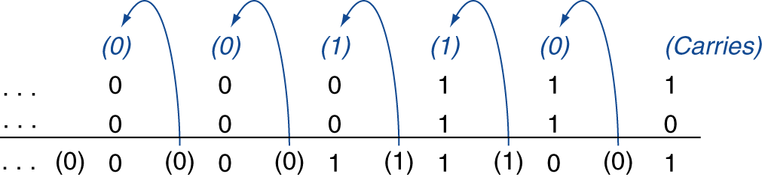
Integer Addition
Example: 7 + 6
§3.2 Addition and Subtraction
Overflow if result out of range
Adding +ve and –ve operands, no overflow
Adding two +ve operands
Overflow if result sign is 1
Adding two –ve operands
Overflow if result sign is 0

Slide 3
Integer Subtraction
Add negation of second operand
Example: 7 – 6 = 7 + (–6)
+7: 0000 0000 … 0000 0111 –6: 1111 1111 … 1111 1010 +1: 0000 0000 … 0000 0001
Overflow if result out of range
Subtracting two +ve or two –ve operands, no overflow
Subtracting +ve from –ve operand
Overflow if result sign is 0
Subtracting –ve from +ve operand
Overflow if result sign is 1

Slide 4
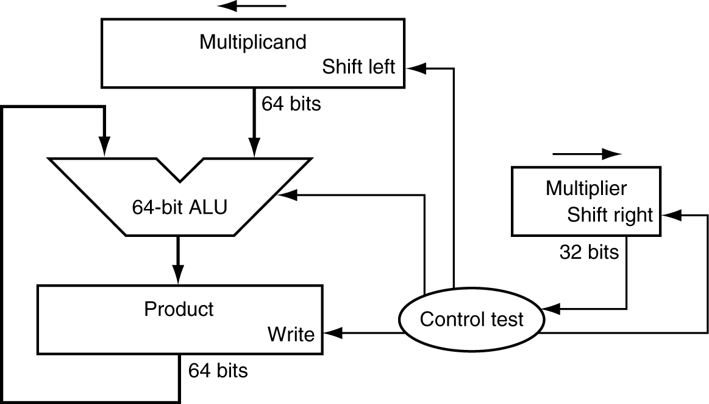
Multiplication
§3.3 Multiplication
Start with long-multiplication approach
multiplicand
1000
× 1001
1000
0000
0000
1000
1001000
multiplier
product
Length of product is the sum of operand lengths

Slide 5
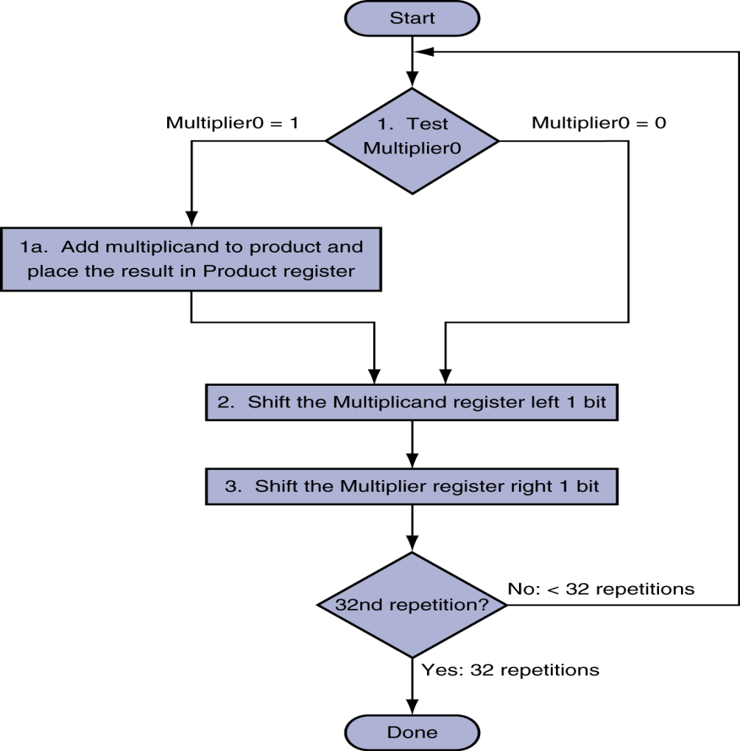
Multiplication Hardware
Initially 0

Slide 6
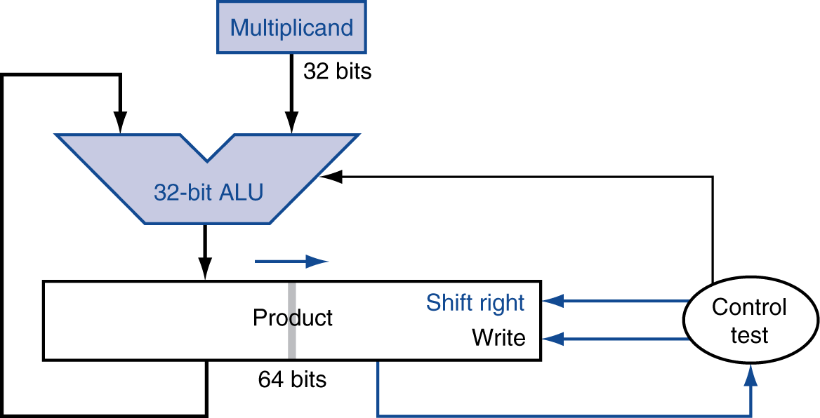
Optimized Multiplier
Perform steps in parallel: add/shift
One cycle per partial-product addition
That’s ok, if frequency of multiplications is low

Slide 7
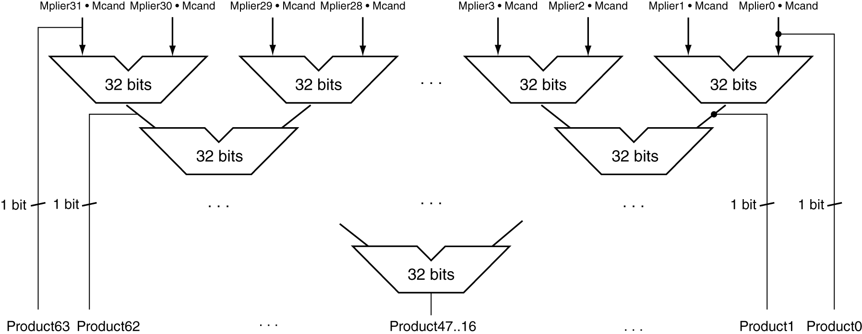
Faster Multiplier
Uses multiple adders
Cost/performance tradeoff
Can be pipelined
Several multiplication performed in parallel

Slide 8
MIPS Multiplication
Two 32-bit registers for product
HI: most-significant 32 bits
LO: least-significant 32-bits
Instructions
mult rs, rt / multu rs, rt
64-bit product in HI/LO
mfhi rd / mflo rd
Move from HI/LO to rd
Can test HI value to see if product overflows 32 bits
mul rd, rs, rt
Least-significant 32 bits of product –> rd

Slide 9
Division
Check for 0 divisor
Long division approach
If divisor ≤ dividend bits
1 bit in quotient, subtract
Otherwise
0 bit in quotient, bring down next dividend bit
Restoring division
Do the subtract, and if remainder goes < 0, add divisor back
Signed division
Divide using absolute values
Adjust sign of quotient and remainder as required
quotient
dividend
1001
1000 1001010
-1000
10
101
1010
-1000
10
divisor
remainder
n-bit operands yield n-bit quotient and remainder

Slide 10
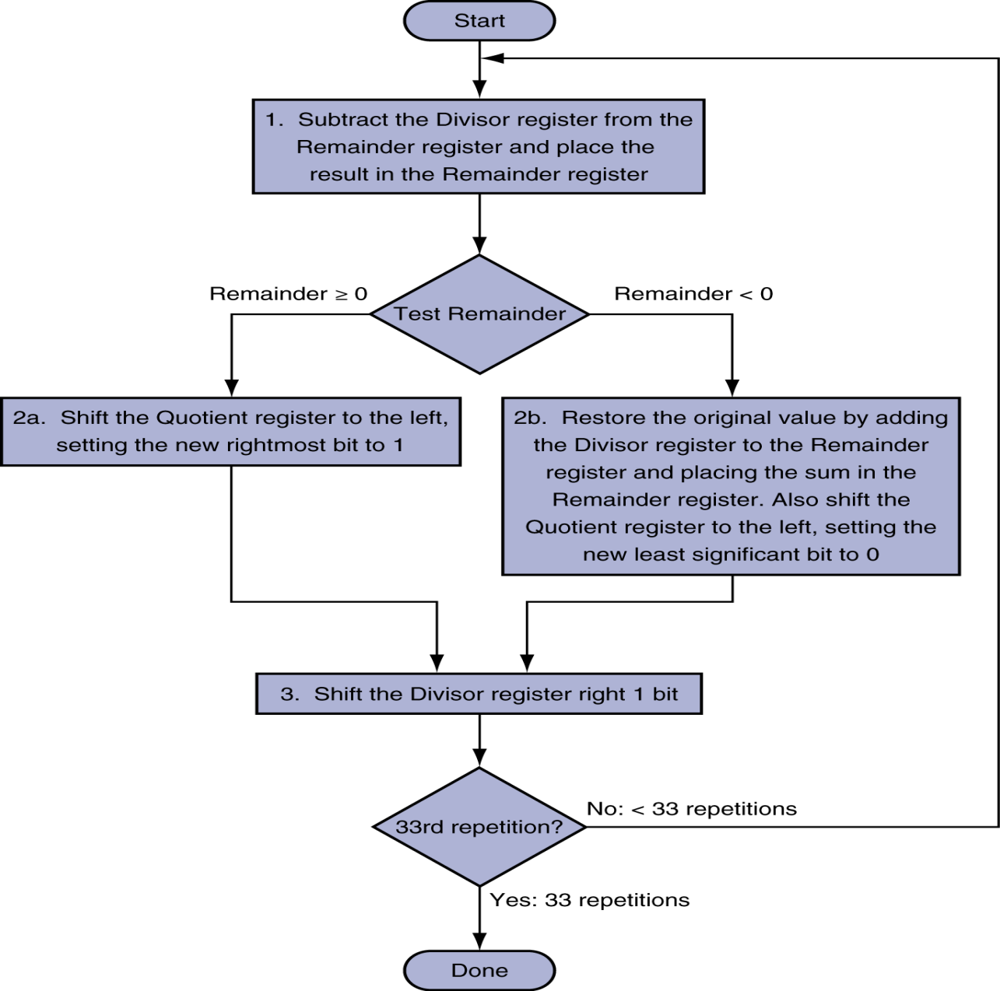
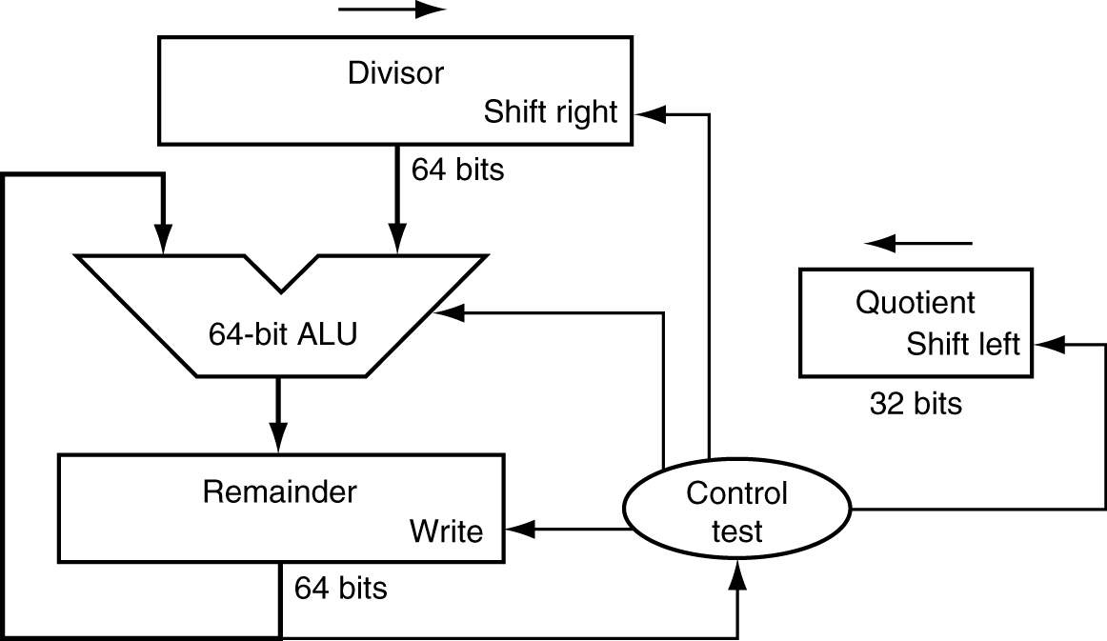
Division Hardware
Initially divisor in left half
Initially dividend

Slide 11
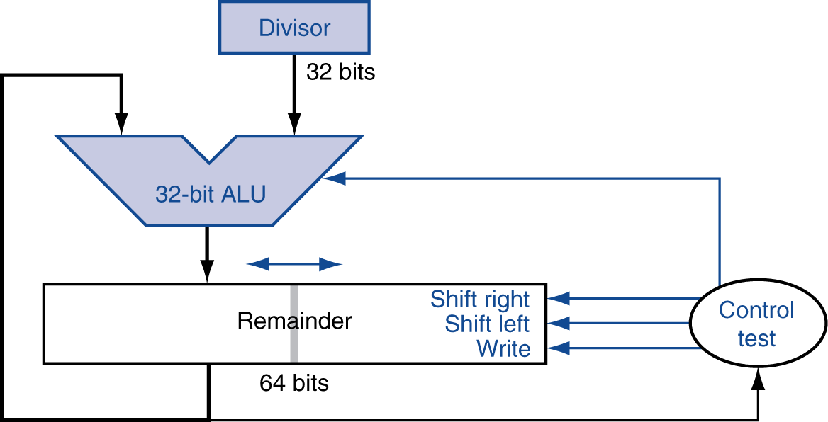
Optimized Divider
One cycle per partial-remainder subtraction
Looks a lot like a multiplier!
Same hardware can be used for both

Slide 12
Faster Division
Can’t use parallel hardware as in multiplier
Subtraction is conditional on sign of remainder
Faster dividers (e.g. SRT devision) generate multiple quotient bits per step
Still require multiple steps

Slide 13
MIPS Division
Use HI/LO registers for result
HI: 32-bit remainder
LO: 32-bit quotient
Instructions
div rs, rt / divu rs, rt
No overflow or divide-by-0 checking
Software must perform checks if required
Use mfhi, mflo to access result

Slide 14
Floating Point
Representation for non-integral numbers
Including very small and very large numbers
Like scientific notation
–2.34 × 10⁵⁶
+0.002 × 10^{–4}
+987.02 × 10⁹
In binary
±1.xxxxxxx₂ × 2^{yyyy}
Types float and double in C
normalized
not normalized

Slide 15
Floating Point Standard
Defined by IEEE Std 754-1985
Developed in response to divergence of representations
Portability issues for scientific code
Now almost universally adopted
Two representations
Single precision (32-bit)
Double precision (64-bit)

Slide 16
IEEE Floating-Point Format
single: 8 bits double: 11 bits
single: 23 bits double: 52 bits
S
Exponent
Fraction
S: sign bit (0 ⇒ non-negative, 1 ⇒ negative)
Normalize significand: 1.0 ≤ |significand| < 2.0
Always has a leading pre-binary-point 1 bit, so no need to represent it explicitly (hidden bit)
Significand is Fraction with the “1.” restored
Exponent: excess representation: actual exponent + Bias
Ensures exponent is unsigned
Single: Bias = 127; Double: Bias = 1023

Slide 17
Single-Precision Range
Exponents 00000000 and 11111111 reserved
Smallest value
Exponent: 00000001 ⇒ actual exponent = 1 – 127 = –126
Fraction: 000…00 ⇒ significand = 1.0
±1.0 × 2^{–126} ≈ ±1.2 × 10^{–38}
Largest value
exponent: 11111110 ⇒ actual exponent = 254 – 127 = +127
Fraction: 111…11 ⇒ significand ≈ 2.0
±2.0 × 2⁺¹²⁷ ≈ ±3.4 × 10⁺³⁸

Slide 18
Double-Precision Range
Exponents 0000…00 and 1111…11 reserved
Smallest value
Exponent: 00000000001 ⇒ actual exponent = 1 – 1023 = –1022
Fraction: 000…00 ⇒ significand = 1.0
±1.0 × 2^{–1022} ≈ ±2.2 × 10^{–308}
Largest value
Exponent: 11111111110 ⇒ actual exponent = 2046 – 1023 = +1023
Fraction: 111…11 ⇒ significand ≈ 2.0
±2.0 × 2⁺¹⁰²³ ≈ ±1.8 × 10⁺³⁰⁸

Slide 19
Representation of Floating Point Numbers
IEEE 754 single precision
31
30
23
22
0
Sign
Biased exponent
Normalized Mantissa (implicit 24th bit = 1)
(-1)^{s} × F × 2^{E-127}
Lec 14
Systems Architecture
19
Notes:
September 4, 1997
19

Slide 20
Floating-Point Precision
Relative precision
all fraction bits are significant
Single: approx 2^{–23}
Equivalent to 23 × log₁₀2 ≈ 23 × 0.3 ≈ 6 decimal digits of precision
Double: approx 2^{–52}
Equivalent to 52 × log₁₀2 ≈ 52 × 0.3 ≈ 16 decimal digits of precision

Slide 21
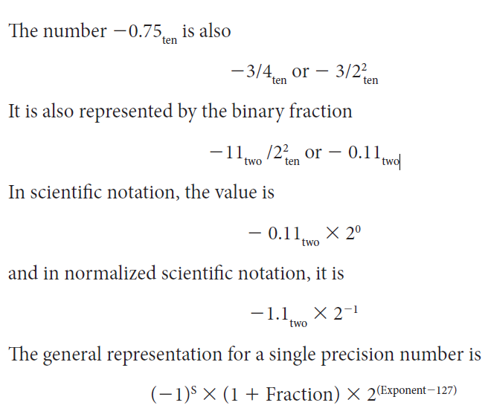
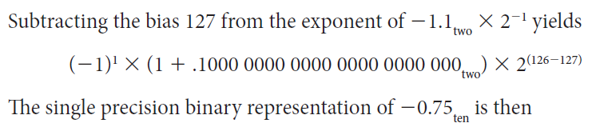
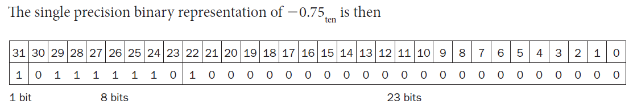
Show the IEEE 754 binary representation of the number 0.75ten in single and double precision

Slide 22
Another example
Represent 7:
Convert to binary: 111
Normalize: 1.11×2²
Sign bit is 0
Biased exponent is 127 + 2 = 10000001_{two}
Coefficient is 1100…0
0
10…01
11000000000000000000000000000

Slide 23
Another example
Represent 1/2
Convert to binary: 0.1
Normalize: 1.0×2⁻¹
Sign bit is 0
Biased exponent is 127 – 1 = 01111110_{two}
Coefficient is 00…0
0
01…10
00000000000000000000000000000

Slide 24
Another example
Represent –2
Convert to binary: 10
Normalize: 1.0×2¹
Sign bit is 1
Biased exponent is 127 + 1 = 10000000_{two}
Coefficient is 00…0
1
10…00
00000000000000000000000000000

Slide 25
Yet another example
Represent –2
Convert to binary: 10
Normalize: 1.0×2¹
Sign bit is 1
Biased exponent is 127 + 1 = 10000000_{two}
Coefficient is 00…0
1
10…00
00000000000000000000000000000

Slide 26
Floating-Point Example
What number is represented by the single-precision float
11000000101000…00
S = 1
Fraction = 01000…00₂
Exponent = 10000001₂ = 129
x = (–1)¹ × (1 + 01₂) × 2^{(129 – 127)}
= (–1) × 1.25 × 2²
= –5.0

Slide 28
T2 Answer Key
Question | S1 | S2
No of clock cycles by 5 stage pipeline to execute x instructions | 1*5+499 = 504 | 1*5+299 = 304
Time for non pipelined machine | 500*10*5 = 25000 ns | 300*15*5 = 22500 ns
Time for pipelined machine | 504*15 = 5040 ns | 304*15 = 4560 ns
Speedup ratio | 25000/5040 = 4.96 | 22500/4560 = 4.93
Clock cycles when not in pipeline | 500*5 = 2500 | 300*5 = 1500

